Slide 1
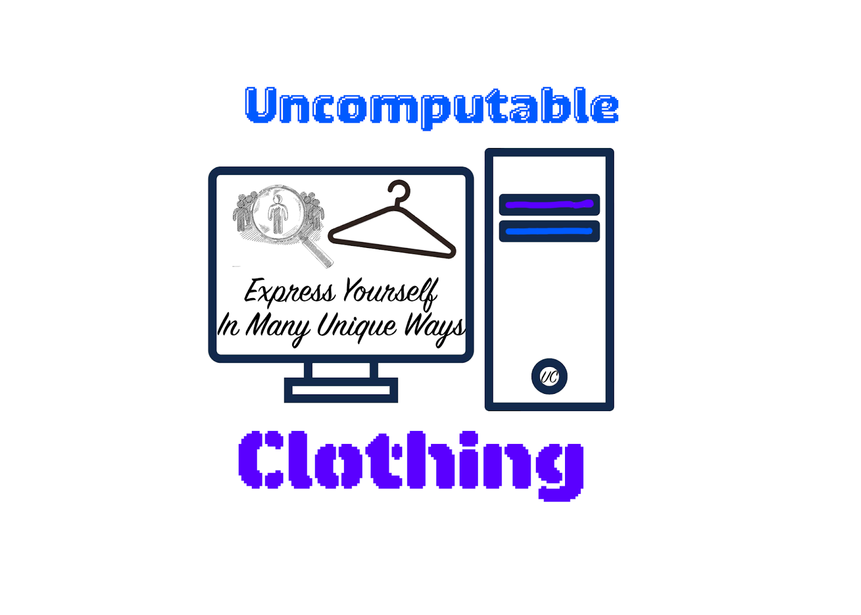
Uncomputable
Clothing
Avier Phillips-Coltrane
Express yourself in many unique ways
HGP Alumni
CEO and Founder
Make clothing designs to make people feel unique
Communities look to much alike
2

Slide 2

Reason/Mission
In southern California I see that most teens are struggling to have their own identity and wanting to be included and not feel like an outcast in the place they want to feel comfortable in
My plan is to have uniqueness help with diversity, and help teens find themselves
So i plan to make clothing a canvas so they can find themselves with fashion
3

Slide 3
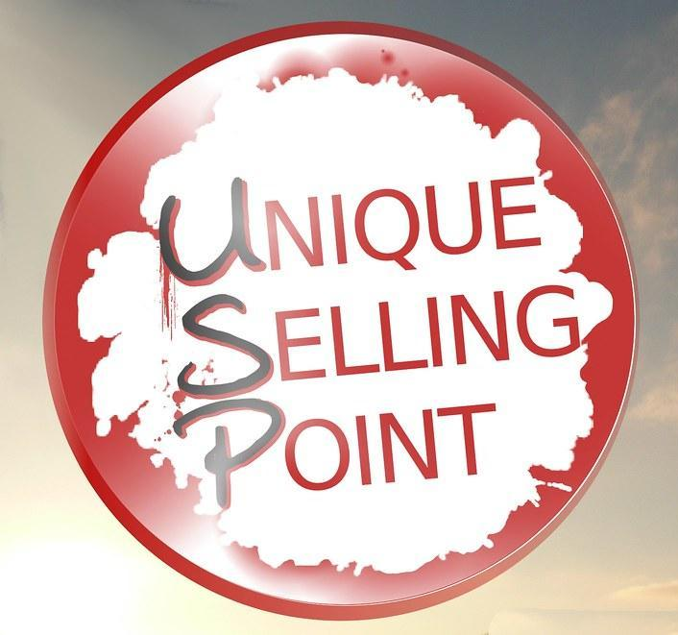
Problem
Clothes may take to much to take care of
If people have already found themselves they may feel different about themselves and start questioning everything they have made themselves feel like.
4

Slide 4
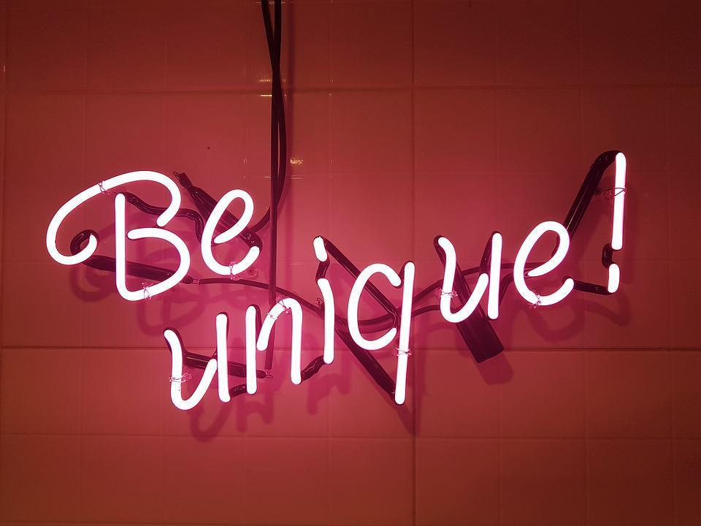
Solution
Make my clothes low-maintenance so they are more sustainable
I could put out a survey that lets people express how they feel about themselves and make their thoughts into premade clothing
5

Slide 5
Market Size
Tam: of clothing market is 567b for Global
Sam: of clothing market is 67m for Southern California
Som: Uncomputable Clothing will have a share of 2% of Southern California’s which is 1.3 million by 2027
6

Slide 6
Business Model
Uncomputable Clothing
We Take a 16% commission from every transaction for customized and 8% for premade
$8,710 dollars $60 Avg. Fee $1.3 Million Dollars
How much i start with to start business which is .0013% of Available Market
Revenue on
Clothes Sold Custom & Premade
2% of available market projected by 2027
60 is all the prices of clothing averaged together
7

Slide 7

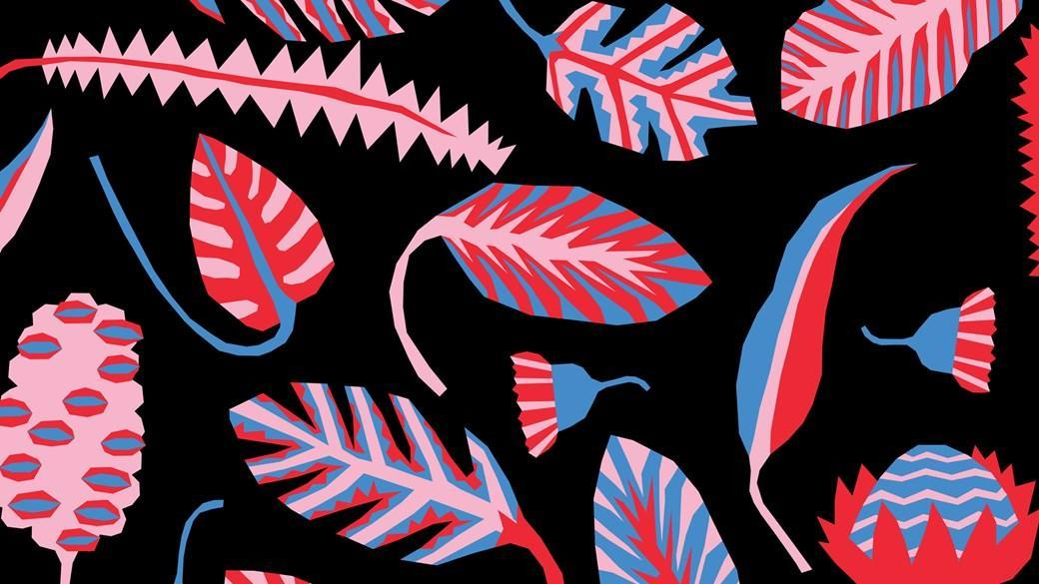
Product Demo &
Proprietary Tech./Expertise
These are 2 of the designs i made
The 1st one is of my hometown which is DownTown, Vancouver, Canada, I made this because its sentimental to me
The 2nd one is of multi-colored florals this gives the offset of being unique which is my main cause
8

Slide 8

Competition
The main competition is GoTit.app, and here is why i stand out from them.
Cheaper prices and higher quality clothing
Customizable clothing options so the designs of the clothing are more up to par
Faster shipping
Doing it for an actual cause rather than just to put out clothes so people can buy, buy, buy.
We do both offline, online, and in-person transactions
VS.
9

Slide 9
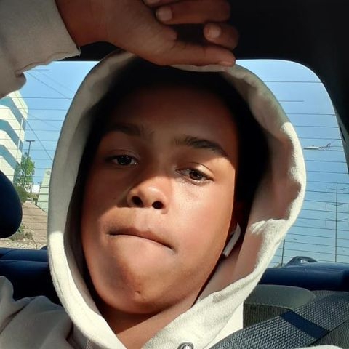
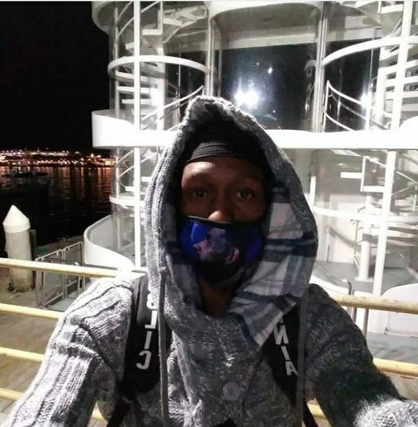
Uncomputable
Clothing’s
Team
Avier Phillips
Founder & CEO
HGP Alum
Junior Entrepreneur
Terrence Coltrane
General Manager
Marketing strategy
10 years exp.
10

Slide 10
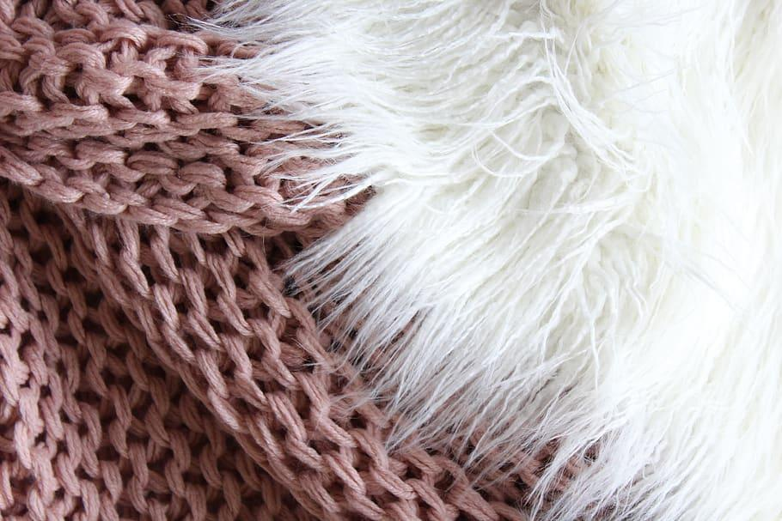
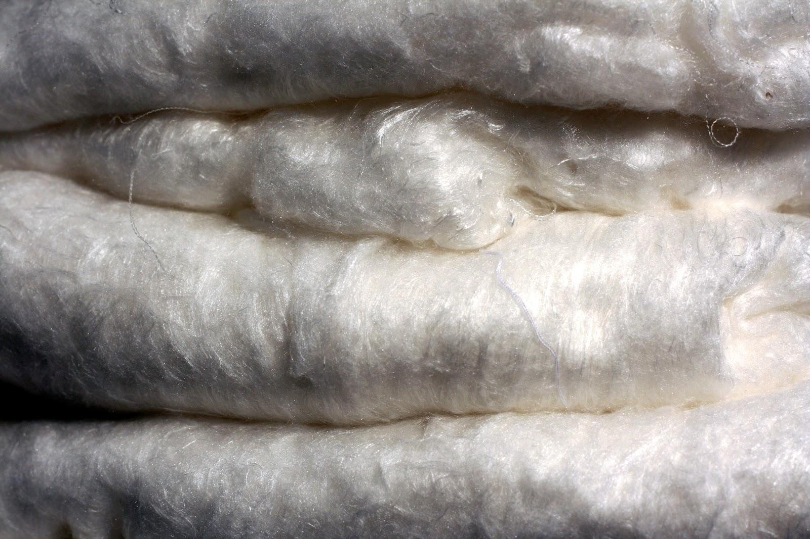
Why US?
You should choose Uncomputable Clothing over other clothing brands because we listen to your suggestions and feedback, and try to replicate it in the best way possible.
We also provide higher valued product to make the clothes which is Supima Cotton and Mulberry Silk.
We also have custom designs that you can choose from or send in drawings if u want a certain design that I don’t have in the options.
The Predmade clothes that don’t sell we give back to the community by giving them away to charities and clothes drives.
11

Slide 11

Market Plan
I plan to use social media to grow my business by advertisements and promotions
Along with that i plan to use my friends, family, and other sources to help sell my clothes and get reviews good & bad so i know if i need to change something or keep it the same.
12

Slide 12
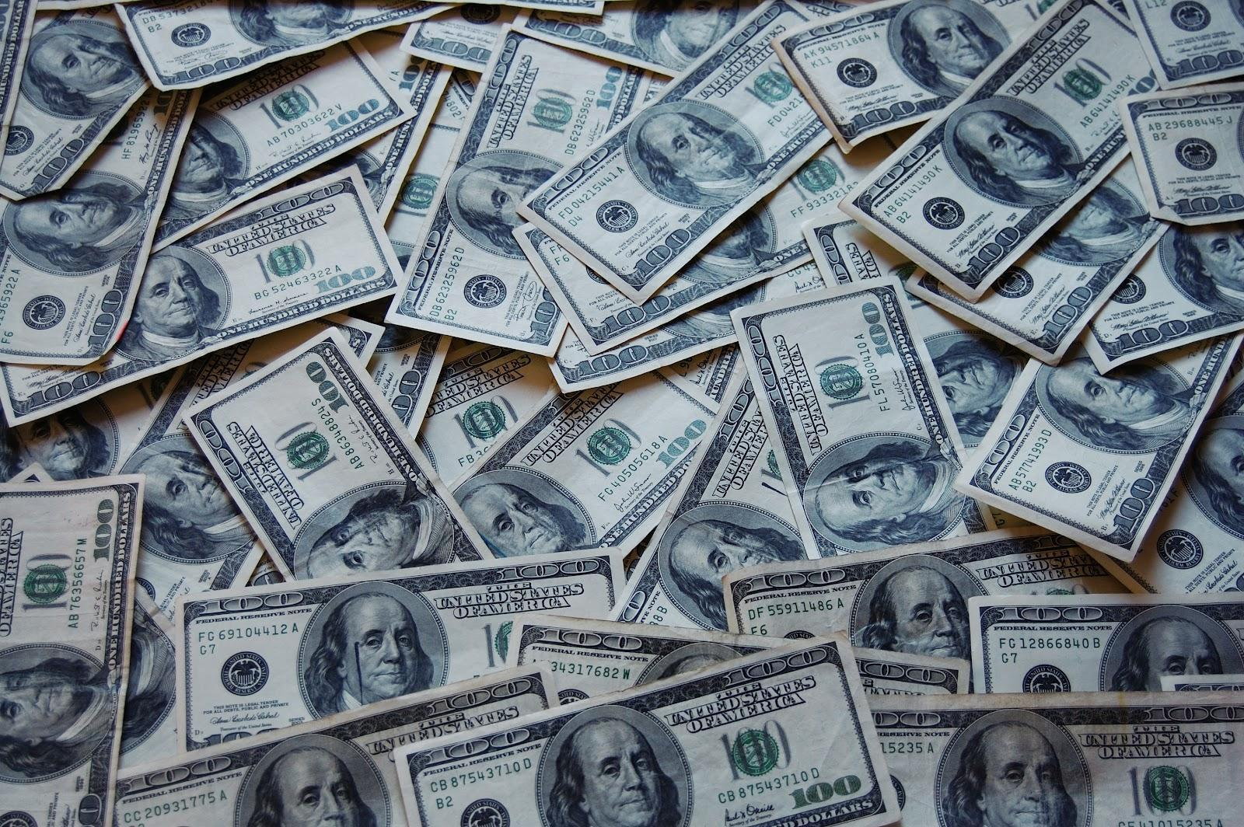
Premade clothing cost-structure
Shipping Fee - $3 - flat cost
International Shipping Fee - $8 - flat cost
Initial Cost - how much to purchase the clothes so i can design it
Manufacturing Cost - how much it takes to make the design and to print it on the shirt
Sub-Final cost - The initial and Design cost added up
Revenue/Profit - what percentage of Sub-Final cost do i want to make back
Final cost - Sub-Final cost + Revenue/Profit percentage
Shirts - $11 + mc $20 = $31, if wants to make 8% - $2.48 + $31 = $33.48
Hoodies - $15 + mc $23 = $38, if wants to make 8% - $3.04 + $38 = $41.04
SweatPants - costs $16 + mc $20 = $36, if wants to make 8% - $2.88 + $36 = $38.88
Joggers - costs $12 + mc $15 = $27, if wants to make 8% - $2.16 + $31 = $33.16
Shorts - costs $18 + dc $10 = $28, if wants to make 8% - $2.24 + $28 = $30.24
Socks - pack of 6 - costs $20 + mc $5 = $25, if wants to make 8% - $2+ $25 = $26.99
Socks - 1 pair - costs $3.33 + mc .75c = $4.08, if wants to make 2% - .8c + $4.08 = $4.16
13

Slide 13

Customizable clothing cost-structure
Shipping Fee - $5 - flat cost
International Shipping Fee - $10 - flat cost
Initial Cost - how much to purchase the clothes so i can design it
Design Cost - how much it takes to make the design and to copyright it
Sub-Final cost - The initial and Design cost added up
Revenue/Profit - what percentage of Sub-Final cost do i want to make back
Final cost - Sub-Final cost + Revenue/Profit percentage
Shirts - costs $11 + dc $45 = $56, if wants to make 16% - $9 + $56 = $63.99
Hoodies - costs $15 + dc $50 = $65, if wants to make 16% - $11 + $65 = $75.99
SweatPants - costs $16 + dc $45 = $61, if wants to make 16% - $10 + $61 = $70.99
Joggers - costs $12 + dc $40 = $52, if wants to make 16% - $7 + $52 = $58.99
Shorts - costs $18 + dc $40 = $58, if wants to make 16% - $9 + $58 = $66.99
Socks - costs $20 + dc $30 = $50, if wants to make 16% - $8 + $50 = $57.99
14

Slide 14

Fundraising and Milestones
Uncomputable Clothing
Plans
To Grow
Pre-Orders Via Social Media
Raising Money to fund
Final Public Launch
M1
July 2022
M2
M3
M4
M5
M6
Sept. 2023
Beta Private Launch to test features and products
New hires for different fields
Gain traction with final products
15

Slide 15
Thank you
Do you have any questions? Avier.phillipscoltrane@hgp.hiddengeniusproject.org +1 323-407-3704 Coming soon.com

